Slide 1
CAR Calibration Meeting CAR Review
AP Team
Jacky Wu, Catherine Qiu, Thomas Kestner
Nov 24, 2014

Slide 2
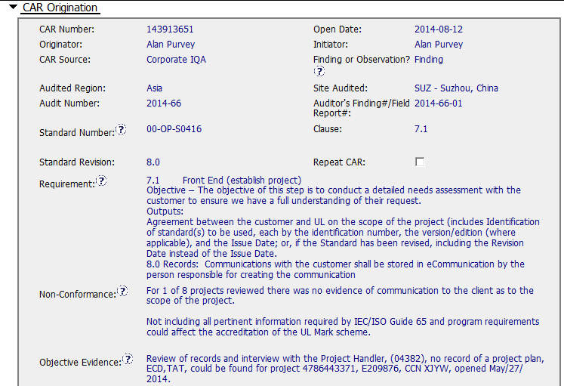
CAR 143913651 - Finding
Clearly identified the Requirement, non-conformance, Objective Evidence.

Slide 3
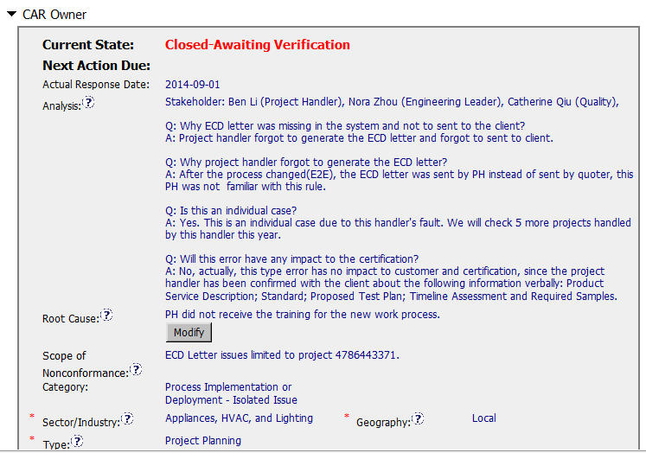
CAR 143913651 - Finding
stakeholders identified;
Analysis shows clear path to root cause and scope;
There are the scope and impact analysis
Root cause statement is succinct, reasonable, complete.
Most appropriate ‘category’, ‘type’, ‘geography’ are selected.
(T) Most appropriate ‘category’, ‘type’, ‘geography’ are selected – Excellent
(C) Analysis shows clear path to root cause and scope; stakeholders identified – Excellent
(C) Root cause statement is succinct, reasonable, complete (Shows ‘N/A’ for observations) – Excellent

Slide 4
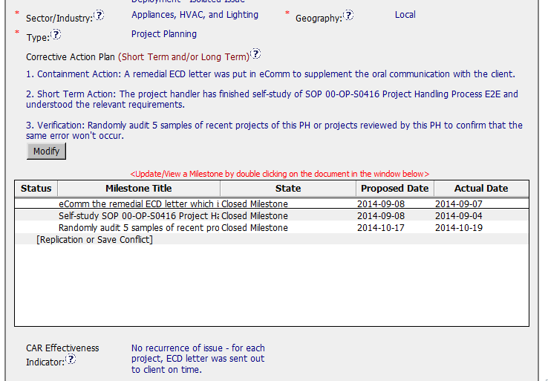
CAR 143913651 - Finding
Corrective actions fix the objective evidence and other problems found; address entire root cause and scope.
Milestones address containment & owner’s verification
(C) Corrective actions fix the objective evidence and other problems found; address entire root cause and scope. - excellent
(C) Milestones address containment & owner’s verification – excellent

Slide 5
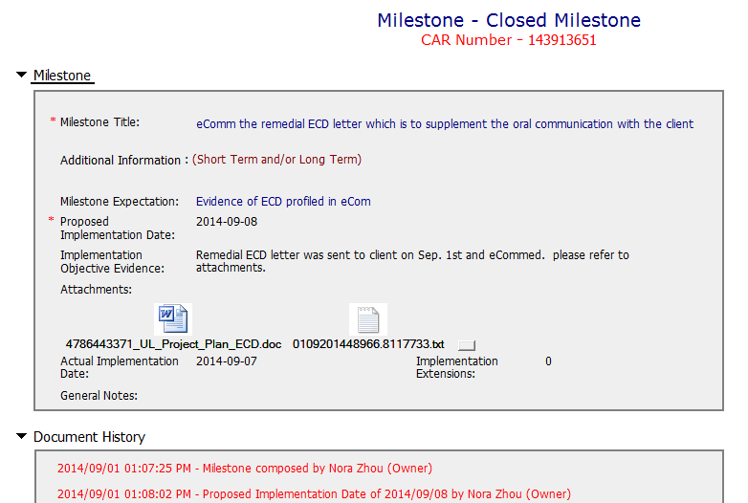
CAR 143913651 - Finding
Milestones completed per milestone expectation.
The objective evidence is attached
(C) Milestones completed per milestone expectations - Excellent

Slide 6
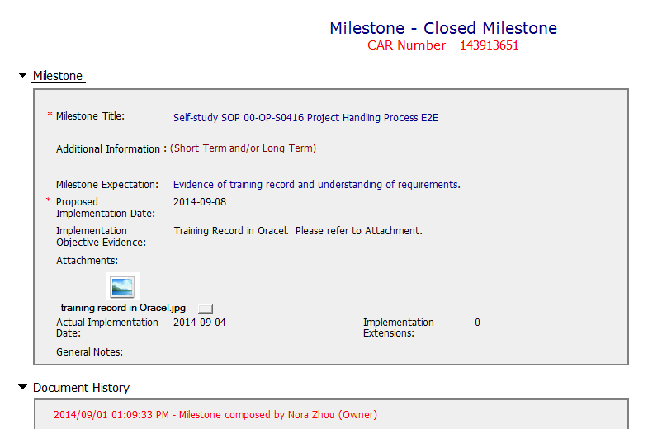
CAR 143913651 - Finding
Milestones completed per milestone expectation.
The objective evidence is attached
(C) Milestones completed per milestone expectations - Excellent

Slide 7
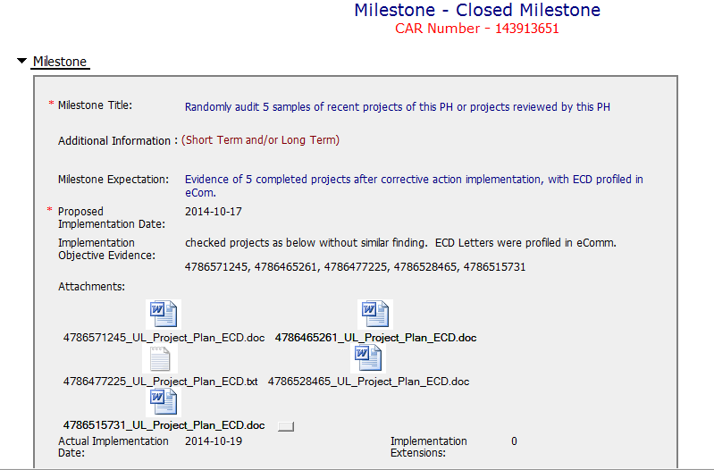
CAR 143913651 - Finding
Milestones completed per milestone expectation.
The objective evidence is attached
(C) Milestones completed per milestone expectations - Excellent

Slide 8
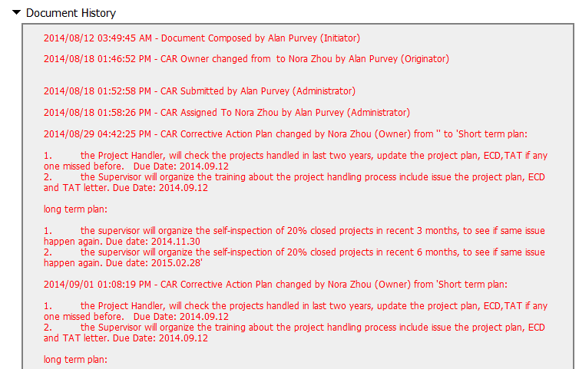
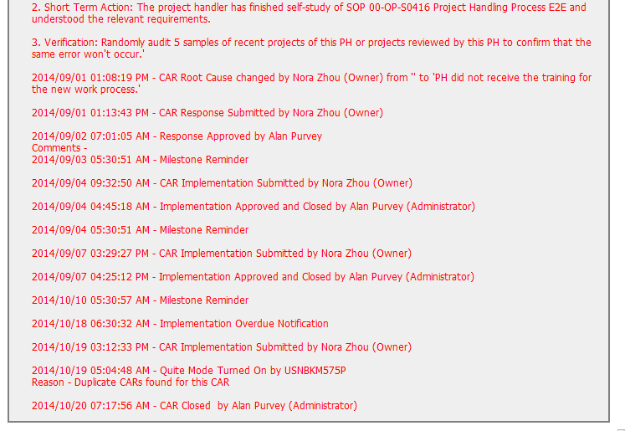
CAR 143913651 - Finding
Acts on CARs within required timeframe.
Timely deal with CAR owner’s response and submit.
(T) Acts on CARs within required timeframe – Excellent
(C) No Extensions, No escalated, No disputed – Excellent

Slide 9
CAR 143913651 – CBS Check
CBS Requirements | Excellent | Moderate | Need Improve | N/A
(C) Extensions are within requirement (<30 days, 3 or less) |  |  |  | X
(T) Most appropriate ‘category’, ‘type’, ‘geography’ are selected | X
(P) Facilitates the handling of disputed CARs |  |  |  | X
(T) Acts on CARs within required timeframe | X
(C) Analysis shows clear path to root cause and scope; stakeholders identified | X
(C) Root cause statement is succinct, reasonable, complete (Shows ‘N/A’ for observations) | X
(C) Corrective actions fix the objective evidence and other problems found; address entire root cause and scope. For observations, they do not go beyond fixing the objective evidence | X
(C) Milestones address containment & owner’s verification; completed per milestone expectations | X
(P) Verification per requirements | X
(L) Referenced communications are attached as needed |  |  |  | X
(C L) Evidence of communication for overdue/escalated CARs and other pertinent concerns |  |  |  | X
(P) Trains other CAR Champions |  |  |  | X

